Slide 1

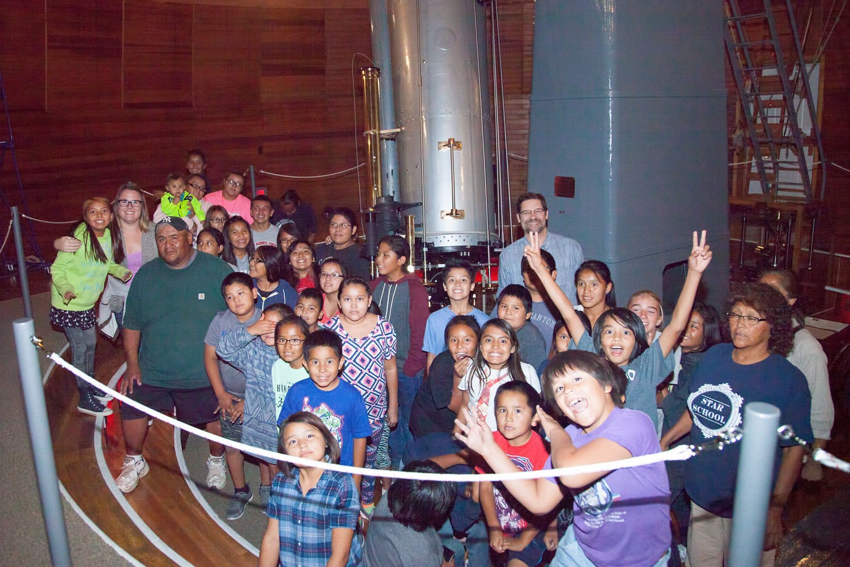
Stars for the Future Project
Image by The STAR School
Intern: Kiril Kirkov
Mentor: Rachel Tso
Team teachers: Tom Tomas, Barry Malpas
Northern Arizona University Department of Physics and Astronomy, The STAR School, Coconino Community College, Lowell Observatory

Slide 2
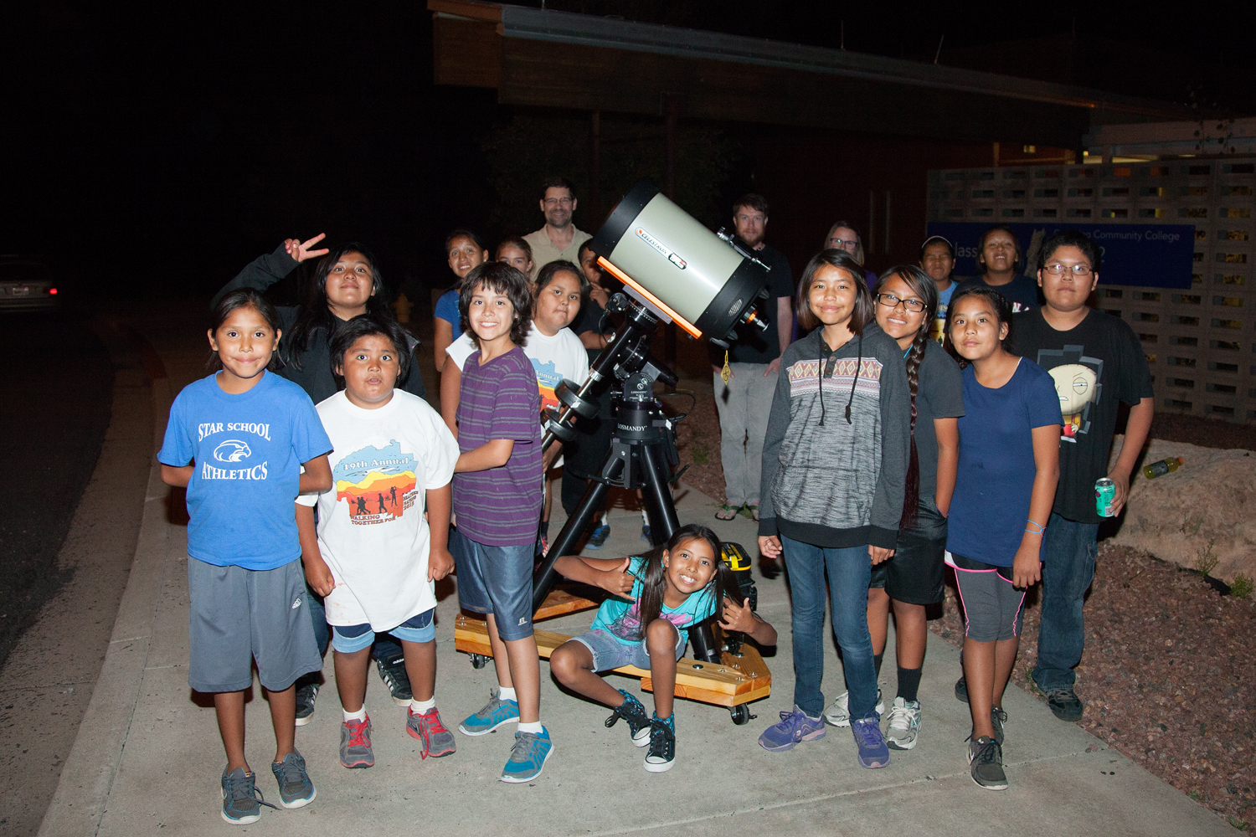
Purpose
The purpose of the project is to explore the science of Astronomy and Planetology with Dine elementary students from the STAR School.
The children will integrate Dine culture and science regarding the Sun, Earth, Moon, and planets.
We hope it will instill an interest and desire in the students to pursue careers in NASA or related science fields.
Image by Ian Salt

Slide 3
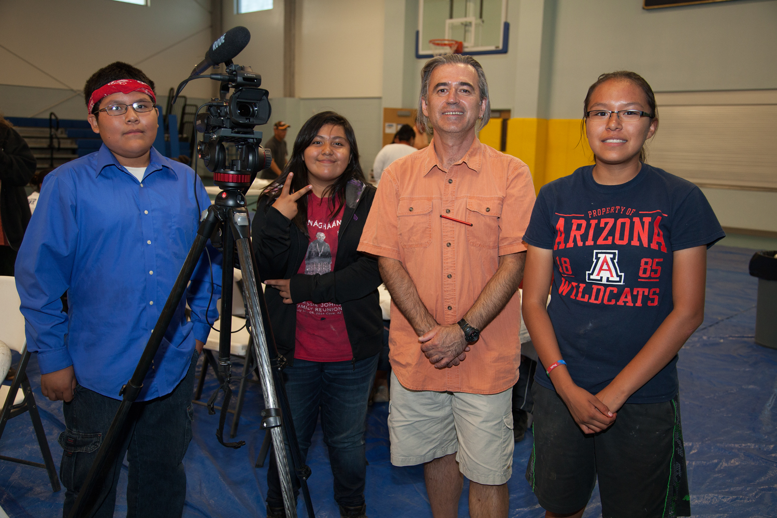
Project Goals
Image by Aydan Thomas
Compare and contrast between Navajo and Western Astronomy.
Express the STAR School four core values: Relationship, Respect, Responsibility and Reasoning.
Develop field skills as astronomers, astrophotographers and filmmakers.
Design and deliver astronomy presentations as evidence of learned content.

Slide 4
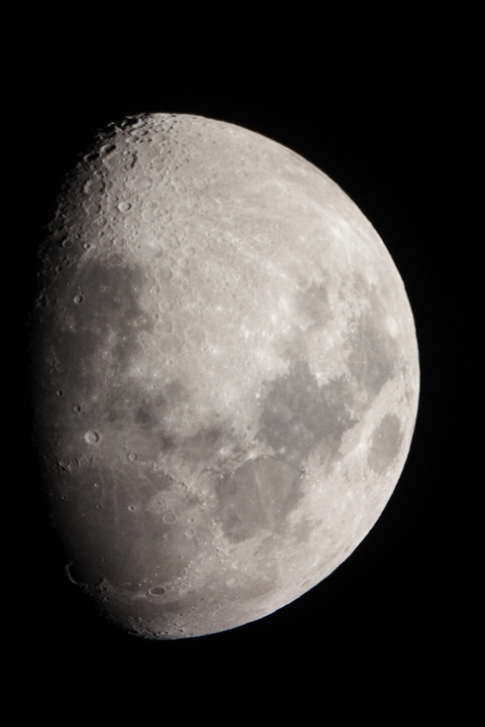
Project Development
Image by Tamia Stos
Telescope observations of the Moon, the Sun and the planets from the Solar System.
Astronomy workshops at the Star School, Coconino Community College and Lowell Observatory.
Astro-photography workshops.

Slide 5
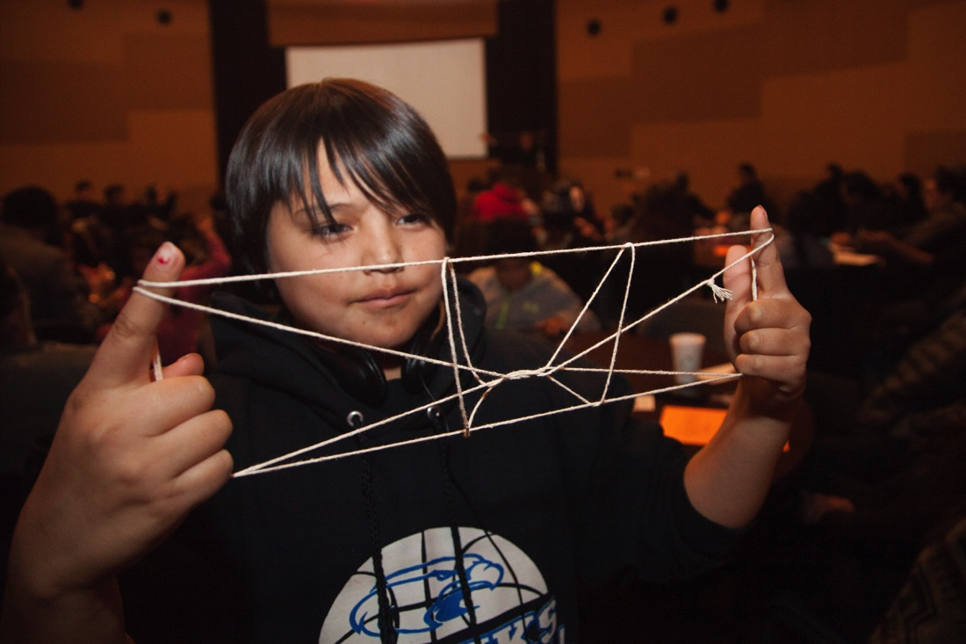
Project Development
Image by Ian Salt
Participating in traditional Navajo astronomy lectures.
MAVEN Project: studying Mars through Navajo cultural perspective.
Studying the differences between science fiction and scientific facts as shown in “The Martian” film.
Visiting Avery Denny’s presentation on Navajo astronomy, winter stories and related string games.

Slide 6
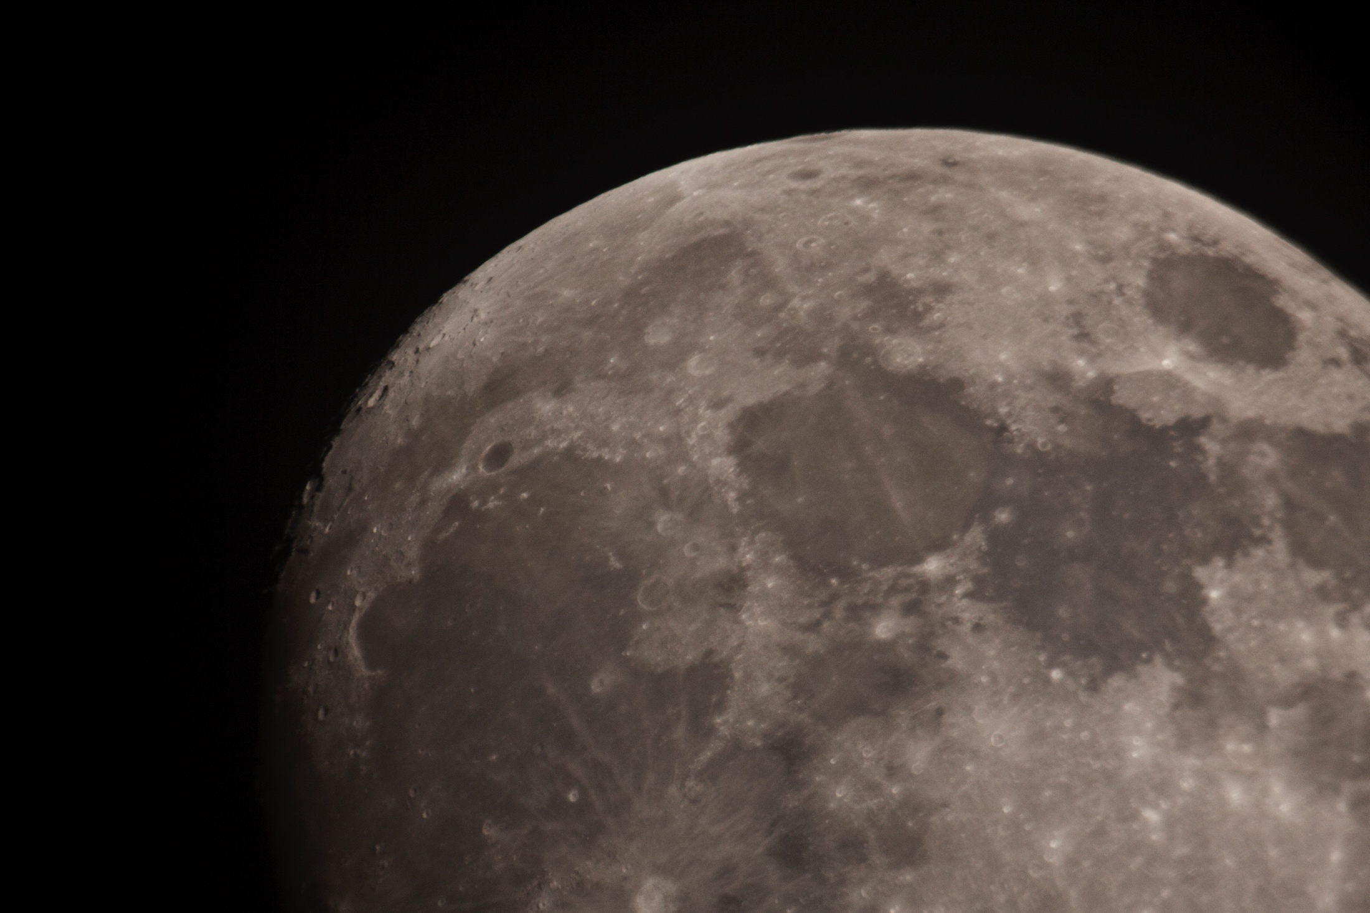
Project Development
Image by Kristopher Cody
Individual and group presentations of learned content at Lowell Observatory.
Producing, directing and filming of a documentary film, based on students’ experiences throughout the project.
Creating a school archive of astronomy photographs.

Slide 7
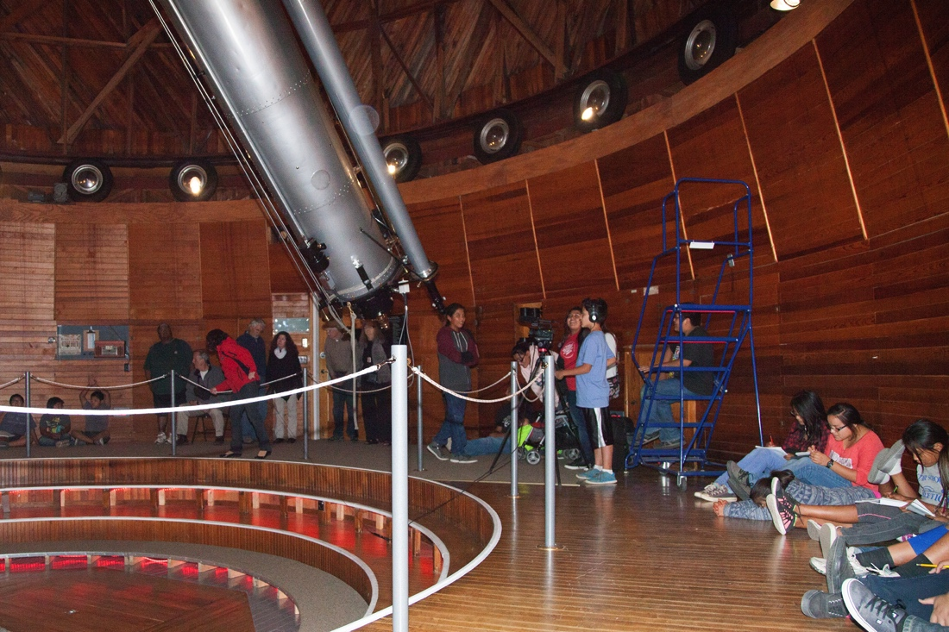
Project Development
Image by Hallie Mego
Trip to NAU Department of Physics and Astronomy and visit with Dr. Nadine Barlow AKA Dr. Mars.
Visit to Lowell Observatory, listen to Dr. Deidre Hunter’s presentation on dwarf galaxies and the life cycle of stars.
Students and families look through the historic 24-inch Clark telescope.

Slide 8
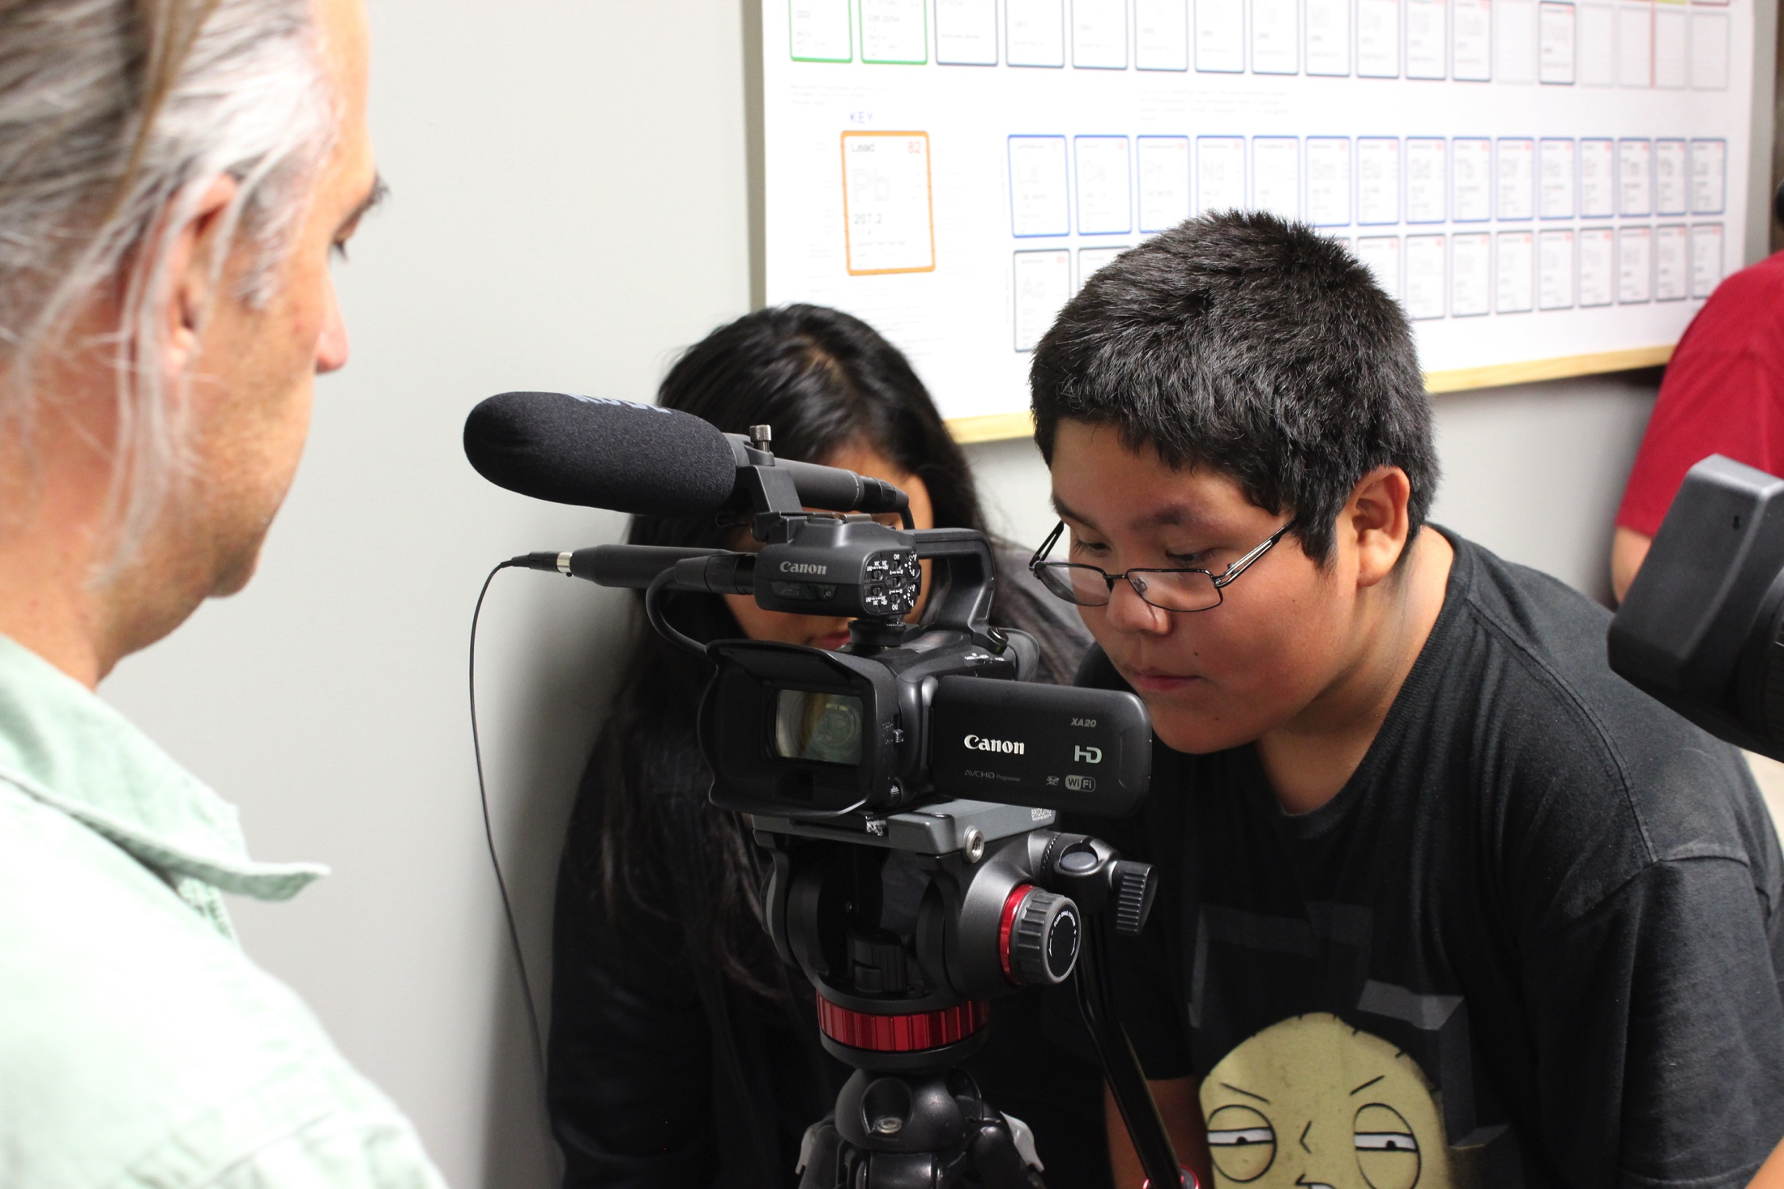
Project Analysis
Image by Ian Salt
Analysis of students’ work provides evidence of meeting project goals.
Traditional storytelling is extended upon through the children’s use of digital media.
The number of participants throughout the project rose from 12 to 45.

Slide 9
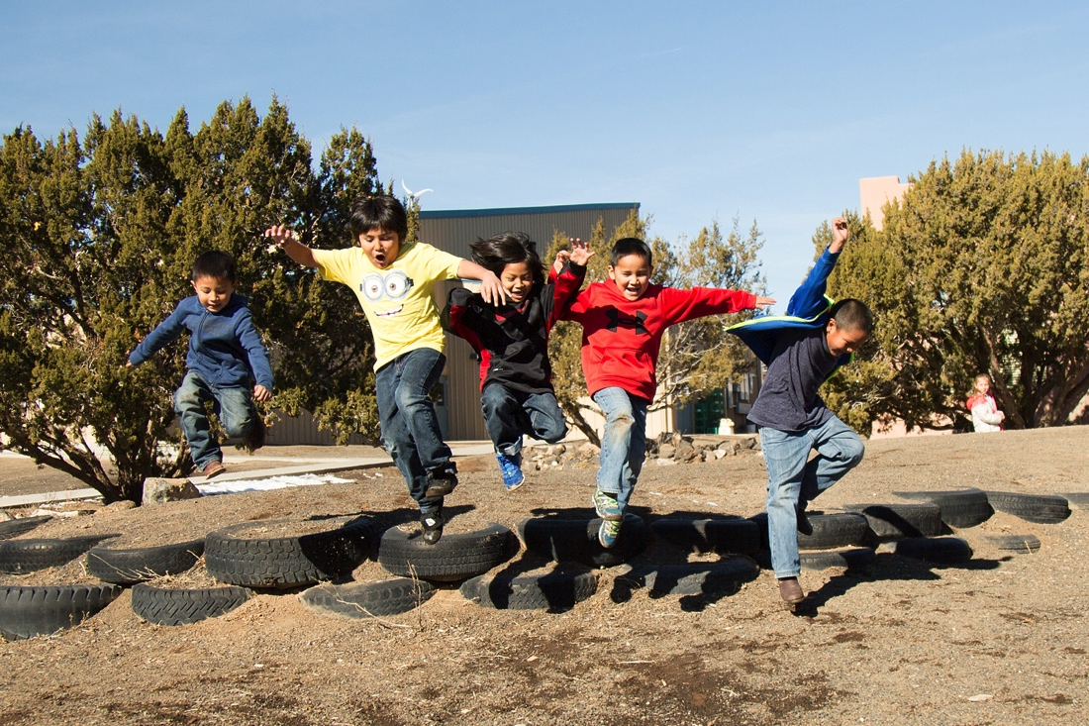
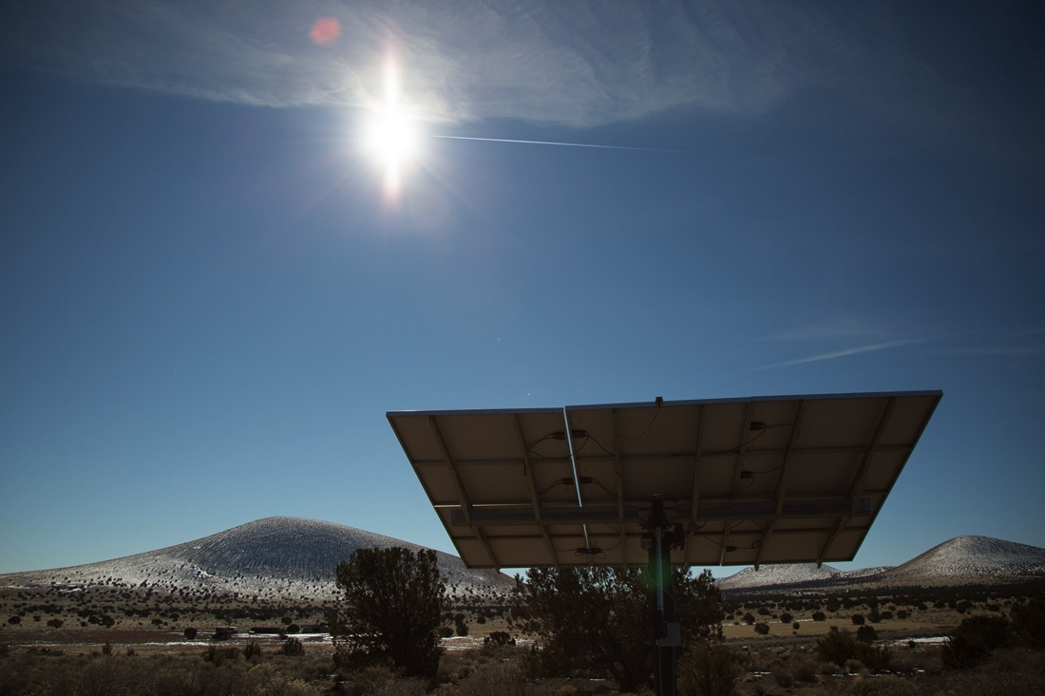
Conclusion
Images by The STAR School
Our vision for this project has been fulfilled.
The STAR School Astronomy Program has grown through the students’ investigation of Dine culture and science.
The students demonstrated engagement and interest through their curiosity and inquiry, as well as their desire to learn new skills and participate in further scientific endeavors.

Slide 10
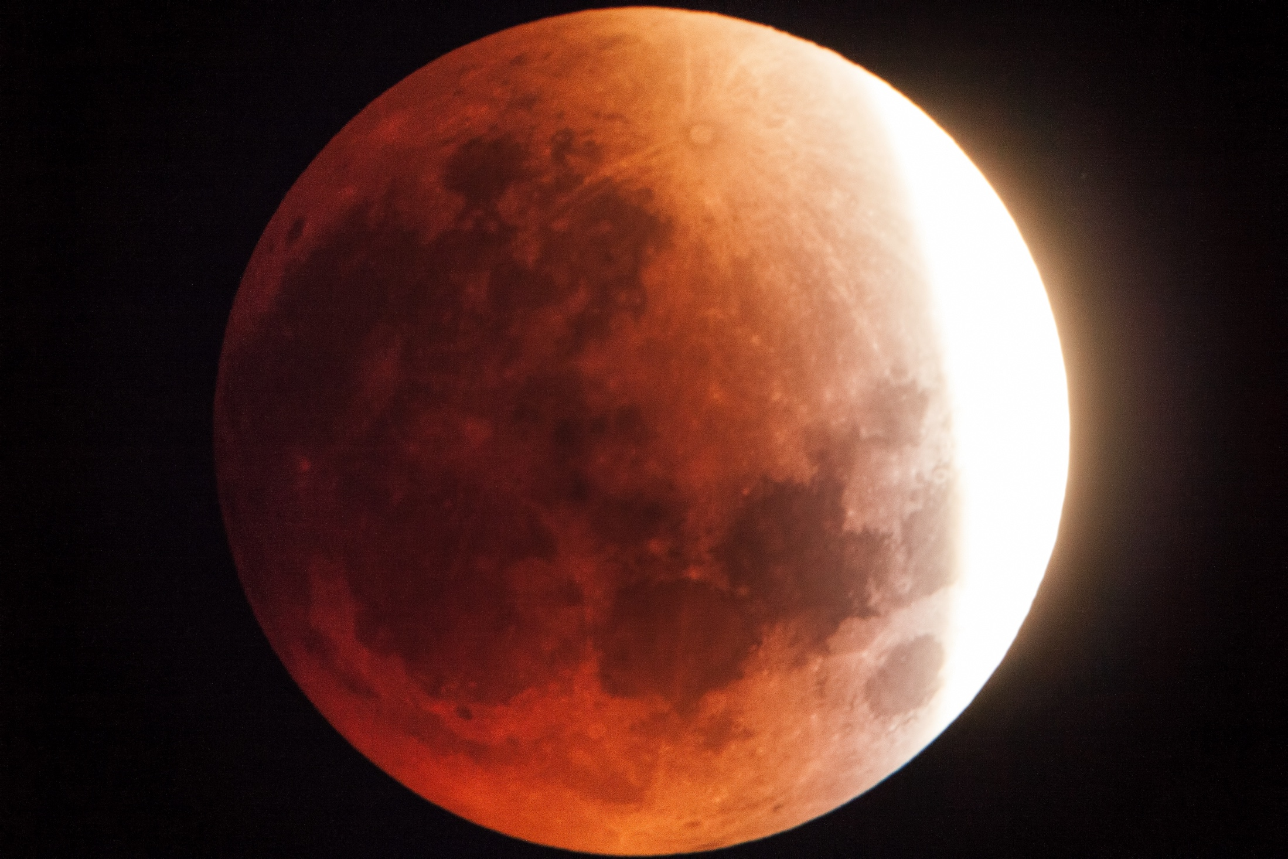
Special Gratitude to:
Image by The STAR School
Dr. Mark Sorensen, Dr. Ingrid Lee, Dr. Nadine Barlow, Dr. David Begay, Dr. Nancy Maryboy, Dr. Deidre Hunter, Kevin Mullins, Jeff Jones, Samantha Gorney, Larry Hendricks, Ike Ozis, Avery Denny, NASA, The STAR School, NAU Department of Physics and Astronomy, NAU School of Communication, Coconino Community College, Lowell Observatory, The Arizona Daily Sun.
Funding Source: NAU/NASA Space Grant Undergraduate Research
Internship Program 2015-2016

Slide 11
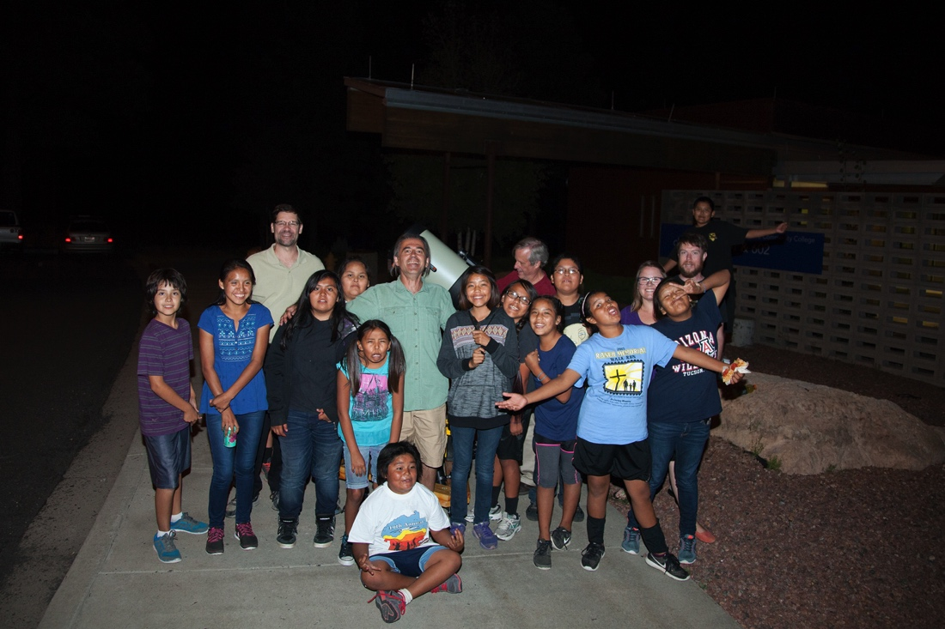

Stars for the Future
Image by The STAR School
Any Questions?

